Slide 1
University of Sarajevo
Partner presentations with special emphasis on their HE research potential and
practices, as well as role in NatRisk
Prof.dr Emina Hadžić
Thursday, 15th December 2016, Niš

Slide 2
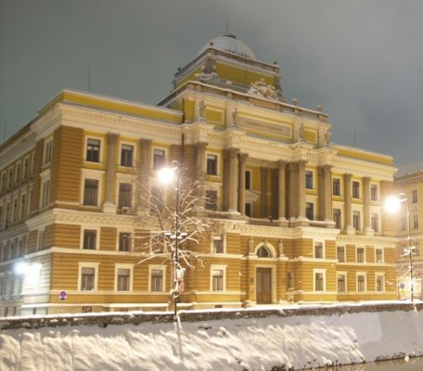
History of University
Sarajevo was first placed on the map of academic centres in this part of Europe in 1573, with the signing of the Waqfname (Book of Endowment) by Gazi Husrev-bey. Today, Gazi Husrev-bey’s Library is, as an associate member, the oldest institution within the University of Sarajevo.
Following the departure of the Ottoman administration and the arrival of Austria-Hungary, the Sharia Judicial Academy was founded in 1887, the National Museum in 1888, the Catholic Seminary of the Vrhbosna Archbishopric in 1890.
The Eastern Orthodox Seminary of Sarajevo was upgraded to an institution of higher learning in 1892.
Today, the National Museum is an associate member of the University of Sarajevo, and the Faculty of Catholic Theology is a full member.

Slide 3
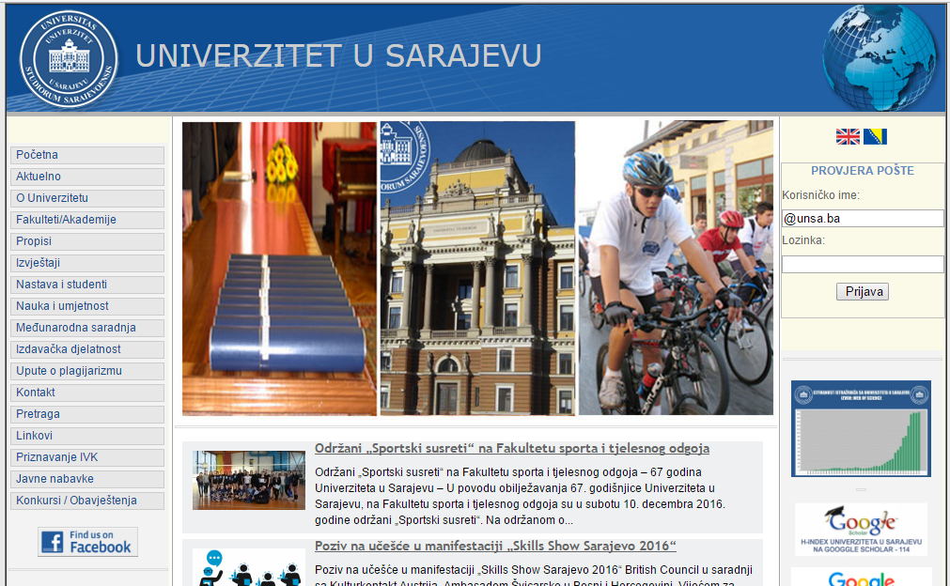
The modern history of the University of Sarajevo began with the establishment of the first secular institutions of higher education before World War II as well as during the war (the Faculty of Agriculture and Forestry in 1940, the Medical Faculty in 1944).
The Medical Faculty was re-established in 1946, the Faculty of Law, the Teacher Training College were opened and, in 1948, the Faculty of Agriculture and Forestry was re-established.
In 1949, the Engineering Faculty / (Technical Faculty) was opened.

Slide 4
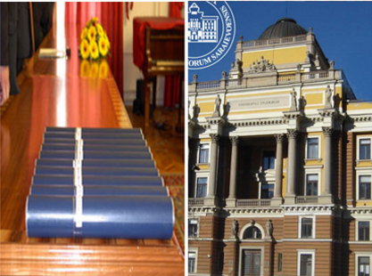
On 2 December of 1949. with the appointment of the first rector, the University of Sarajevo was established.
With the opening of the Faculty of Philosophy (1950) and the Faculty of Economics (1952) the initial phase of establishment of the Sarajevo University was completed.

Slide 5
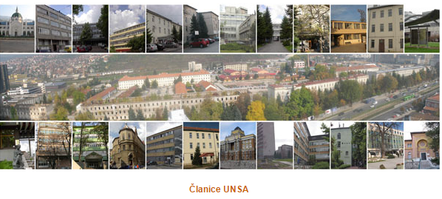
In terms of organisation, the University of Sarajevo today is a large and complex public institution, comprising 30 organisational units: 22 faculties, 3 academies, and 5 research institutes, in six areas of academic work:
social science,
humanities,
medicine,
technical studies,
science,
bio-technology and art
Associate members of the University include the National and University Library of BiH, Gazi Husrev-bey’s Library and the National Museum, as well as other units.

Slide 6
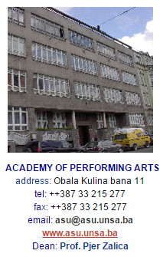
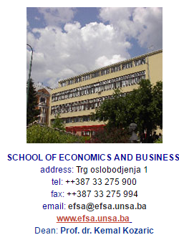
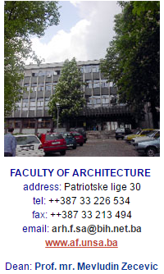
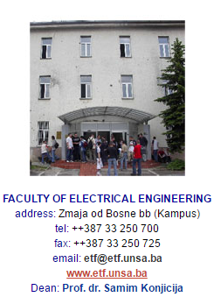
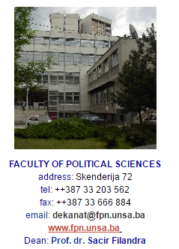
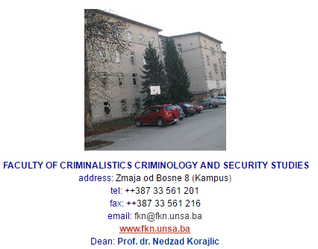

Slide 7
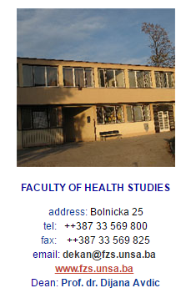
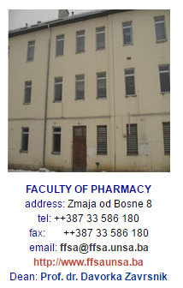
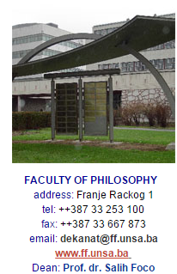
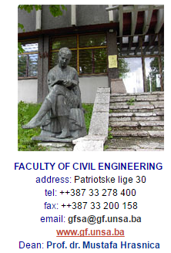
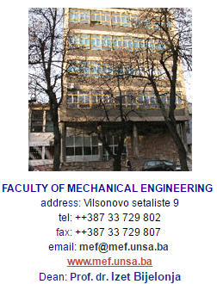
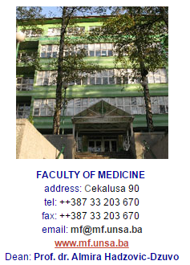
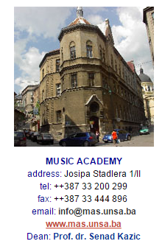

Slide 8
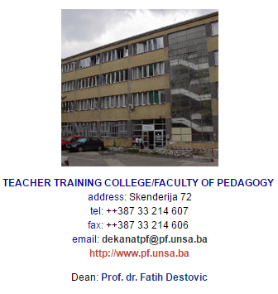
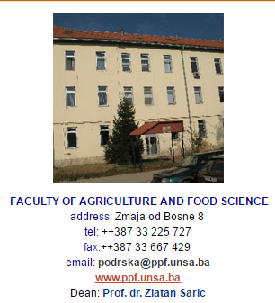
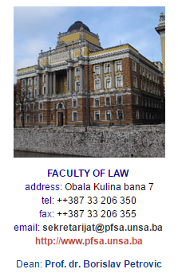
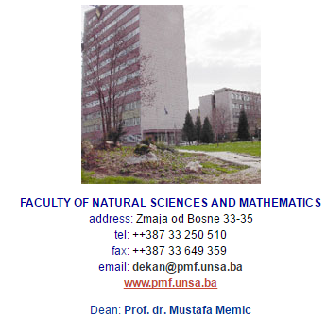
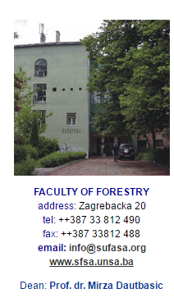

Slide 9
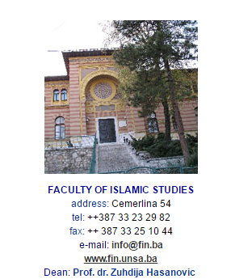
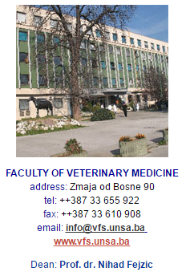
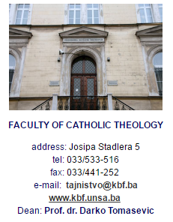

Slide 10
University of Sarajevo
Founded 1949
24 Faculties and associated members
(Institutes, Laboratories, Libraries, etc.)
1.795 employees
55.000 students attend currently
UNTIL NOW:
122.000 students graduated,
3891 candidates obtained M.Sc. degree
2284 candidates obtained Ph.D. in 43 different scientific field
Uni Sarajevo has established partnerships with more than 40 Universities from Europe, America, Asia, Africa.
Undergoing academic reconstruction implies the implementation of a new organizational and functioning concept of the University to be compliant with contemporary standards, curricula updating and education of needed faculty.

Slide 11
University of Sarajevo is a partner in many mobility programs (ERASMUS MUNDUS, CEEPUS, bilateral agreements).
List of project for which your organisation has received financial support from EU programmes in last calendar year (Tempus / Erasmus+/ etc.).
Programme or initiative | Reference number | Beneficiary Organisation | Title of the Project☒
TEMPUS | 530755-TEMPUS-1-2012-1-BA-TEMPUS-JPCR | University of Sarajevo | Curricular reform of heritage sciences in Bosnia and Herzegovina
TEMPUS | 517097-TEMPUS-1-2011-1-BA-TEMPUS-JPGR | University of Sarajevo | Quality in Research
TEMPUS | 516939-TEMPUS-1-2011-1-BA-TEMPUS-SMHES | University of Sarajevo | Equal Opportunities for Students with Special Needs in Higher Education
TEMPUS | 544108-TEMPUS-1-2013-1-RS-TEMPUS-JPHES | University of Arts | Creating a collaborative environment in the field of arts and media through regional student partnership in production of audio/video content
TEMPUS | 544182-TEMPUS-1-2013-1-IT-TEMPUS-JPCR | Universita degli Studi di Milano | Public Health in the Western Balkans - Improvement in the Field of Public Health and Development of a "One Health" Educational and Scientific Architecture
TEMPUS | 544595-TEMPUS-1-2013-1-HR-TEMPUS-JPHES | University of Zagreb | Lifelong learning for sustainable agriculture in Alps-Danube-Adriatic Region

Slide 12
Programme or initiative | Reference number | Beneficiary Organisation | Title of the Project☒
TEMPUS | 530554-TEMPUS-1-2012-1-SK-TEMPUS-JPHES | Slovak University of Technology in Bratislava | Network for education and training for public environmental laboratories
TEMPUS | 530696-TEMPUS-1-2012-1-BE-TEMPUS-SMGR | Katholieke Hogeschool Sint-Lieven | Benchmarking as a Tool for Improvement of Higher Education Institution Performance
TEMPUS | 530730-TEMPUS-1-2012-1-RS-TEMPUS-JPHES | University of Belgrade | Development of Policy-Oriented Training Programmes in the Context of the European Integration
TEMPUS | 517319-TEMPUS-1-2011-1-UK-TEMPUS-JPCR | Roehampton University | Developing Human Rights Education at the Heart of Higher Education
TEMPUS | 517117-TEMPUS-1-2011-1-IE-TEMPUS-JPHES | Limerick Institute of Technology | Developing information literacy for lifelong learning and knowledge economy in Western Balkan countries.
TEMPUS | 516891-TEMPUS-1-2011-1-DE-TEMPUS-SMGR | University of Heidelberg | Embedding Quality Assurance in Doctoral Education
ERASMUS MUNDUS ACTION 2 | 2010-4728/001-001-EMA2 | City University London, UK | EM2STEM stands for: Erasmus Mundus 2 Science, Technology, Engineering, Mathematics
ERASMUS MUNDUS ACTION 2 | 2010-2538/001-001-EMA2 | Karl-Franzens-Universität Graz, Office for International Relations, Austria | JoinEU-SEE II
ERASMUS MUNDUS ACTION 2 | 204470-EM-1-2011-1-AT-ERA-MUNDUS-EMA21 | Karl-Franzens-Universität Graz, Office for International Relations, Austria | JoinEU-SEE III

Slide 13
Role in NatRisk
UNSA will help in development and implement new master study programme and participate in development and implementation of trainings in NDRM for citizens and public sector.
Great contribution to the study of natural disasters can be given through studying the impact of urbanization and spatial planning to the built environment and the frequency of occurrence of natural disasters. In this regard, special attention will be paid to the use of modern techniques and tools in the teaching and learning process.
Due to the frequency of floods, landslides and torrents, especially attention will be paid to exploration of the causes as well as methods of prevention and rehabilitation.
Also, great importance will be given to the study of climate change impacts on water resources and on the environment in general.
The problem of earthquakes will be also part of the study programme.
UNSA will also participate in all project activities, fulfilling assignements and activities up to date.

